Slide 1
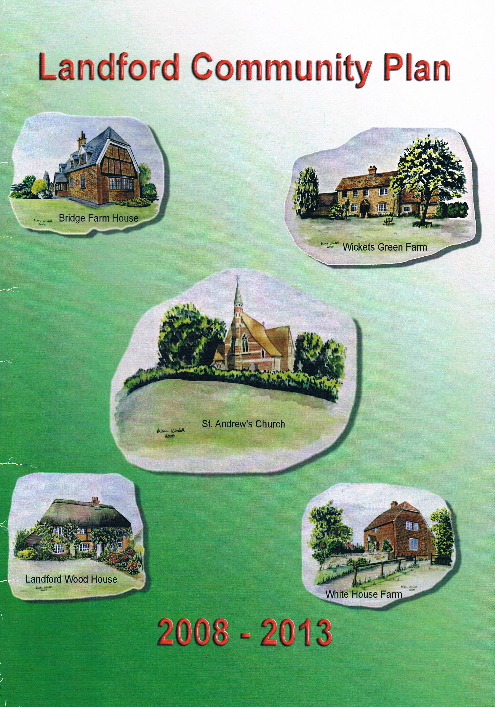
Plan Development
Public Meetings
Collection of ideas and interests
Attending events
Consultation with the community
Assembling the information to develop the Questionnaire
Distribution and collection of the Questionnaire
Collection and production of the results
With an 83% return the Parish Council, Wiltshire Council and the NFNPA could see the interest and value of directing resources to our community
As a result funds were made available and new community groups were formed

Slide 2
Some of the achievements in the plan included:-
Formation of the Community Partnership to help keep issues alive
S1 Village Character - Benches and other facilities
S2 Community Spirit - Village events e.g. 1st Scarecrow event
S3 Communications - Use of Horizon, Website development, Welcome Pack
S4 Leisure Facilities - Parish Pastimes etc.
S5 Public Services - Higher profile of Neighbourhood Watch
S6 Local Businesses - Village Directory
S7 Public transport - Increased bus service to every hour
S8 Environment - NFNPA E. Study, funding Landford Bog, Enviro. Groups
S9 Waste management - Support for more recycling - especially plastic
S10 Housing - Development of the Landford Village Design Statement
S11 Roads - Speed Watch and Lorry Watch formed.
S12 Walking & S13 Cycling - New sections, for 2022-2007

Slide 3
2022-2027 Plan
The new Plan, worked on over the last 4+ years
More complex - larger Parish
Representatives from all the communities helped to devise and deliver the Questionnaire to all households
An excellent result with a 66% return
Feedback showed a great deal of interest in improving and enhancing village life within the Parish
Importance to be part of the National Park
Keen to maintain village character and prevent urbanisation

Slide 4
Next Steps
Sharing the Plan with the Parish Council, Wiltshire Council, New Forest National Park Authority and other organisations so that they can use it to help enhance our community
Publicise the wishes of the community to help form action groups and funding to implement items identified in the Plan
Promote new membership of the Landford Parish Community Partnership to help carry forward the aims and actions highlighted within the Plan

Slide 5
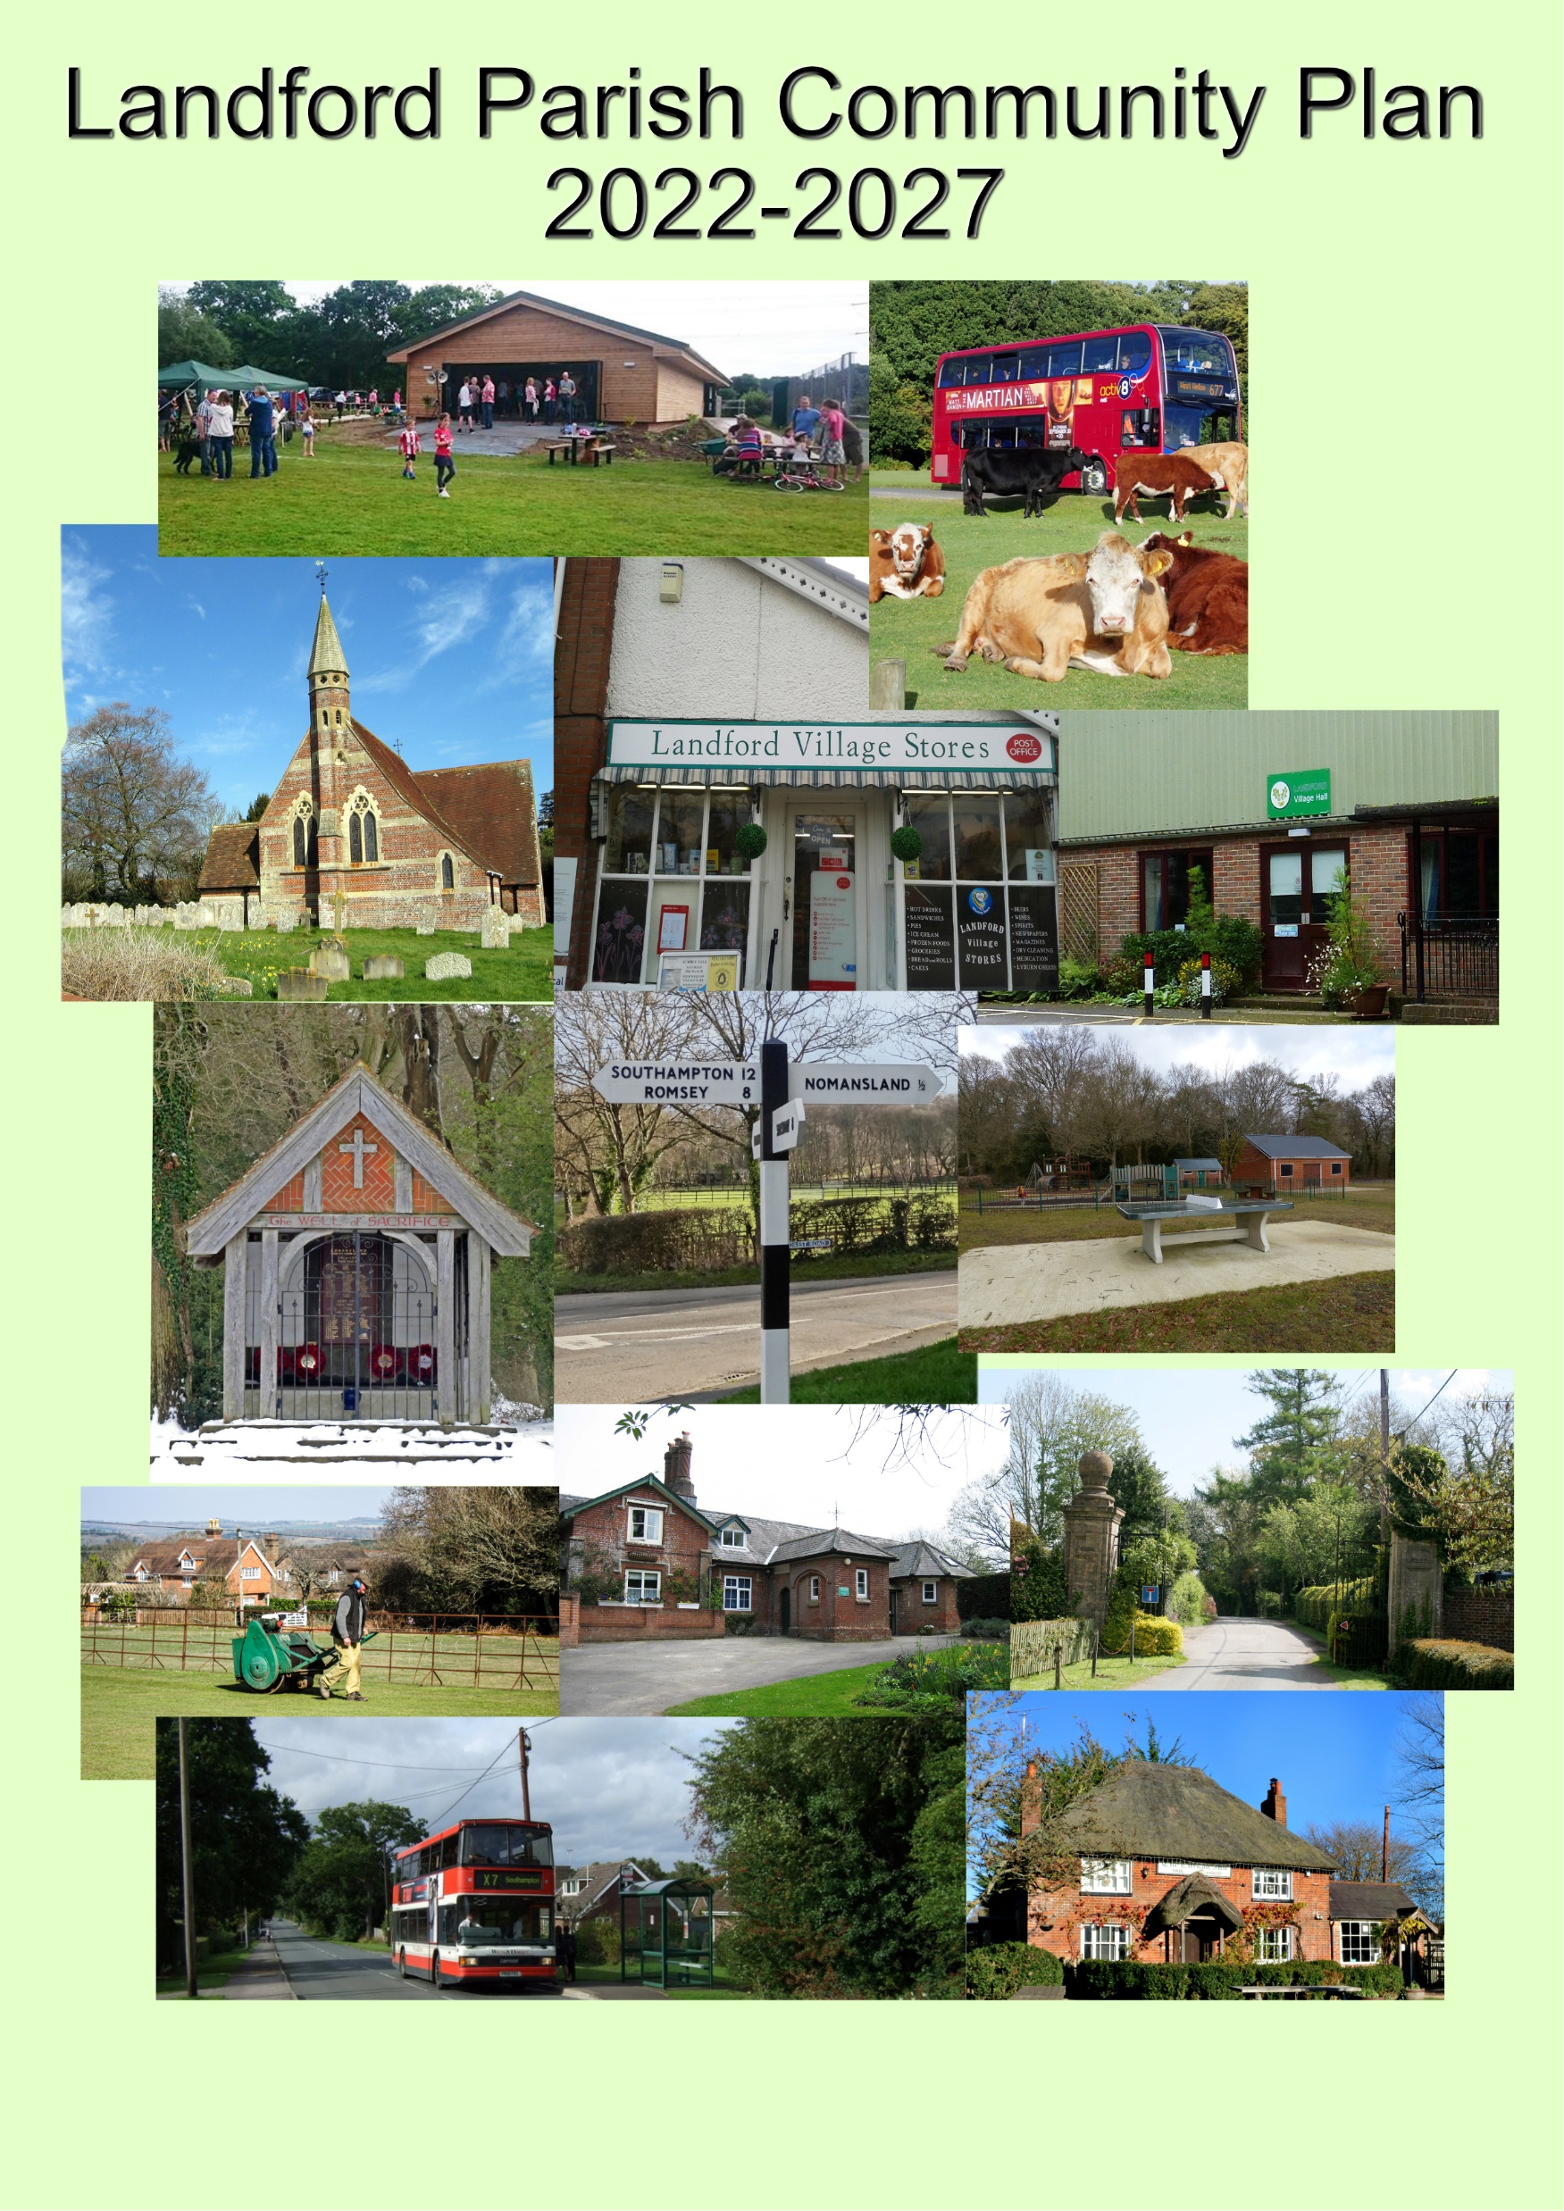
Achievements 2022-2027?
S1 Village Character –
S2 Community Spirit –
S3 Communications –
S4 Leisure Facilities –
S5 Public Services -
S6 Local Businesses –
S7 Public transport –
S8 Environment –
S9 Waste management –
S10 Housing –
S11 Roads –
S12 Walking -
S13 Cycling -
?

