Slide 1
LPC - AGM Community Speed Watch
John Fairhurst 11th May 2022

Slide 2
History
&
Overview
Voice
of the Community
Actions
taken
Support
Keep our Parish roads safe
LPC - AGM Community Speed Watch
John Fairhurst 11th May 2022

Slide 4
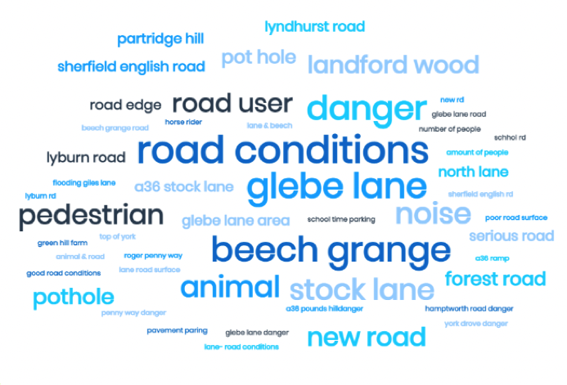
Voice of the Community
Keep our Parish roads safe
John Fairhurst 11th May 2022

Slide 5
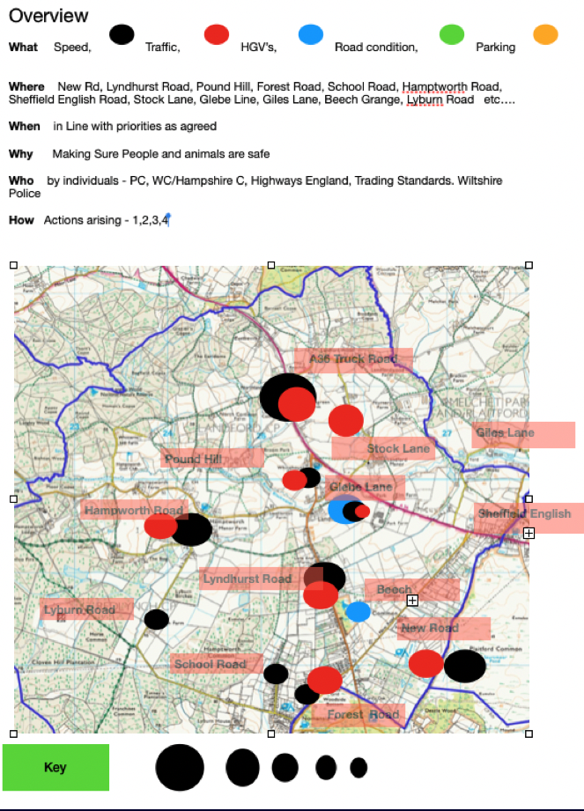
Voice of the Community
Keep our Parish roads safe
John Fairhurst 11th May 2022

Slide 6
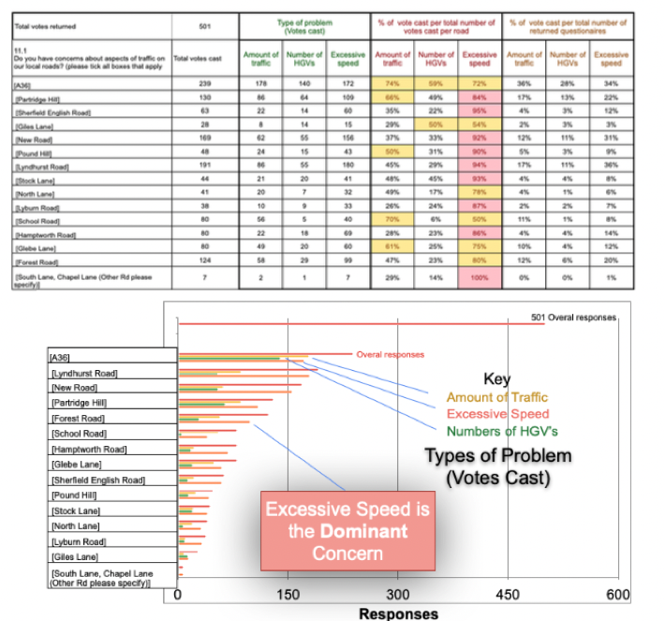
Voice of the Community
Keep our Parish roads safe
John Fairhurst 11th May 2022

Slide 7
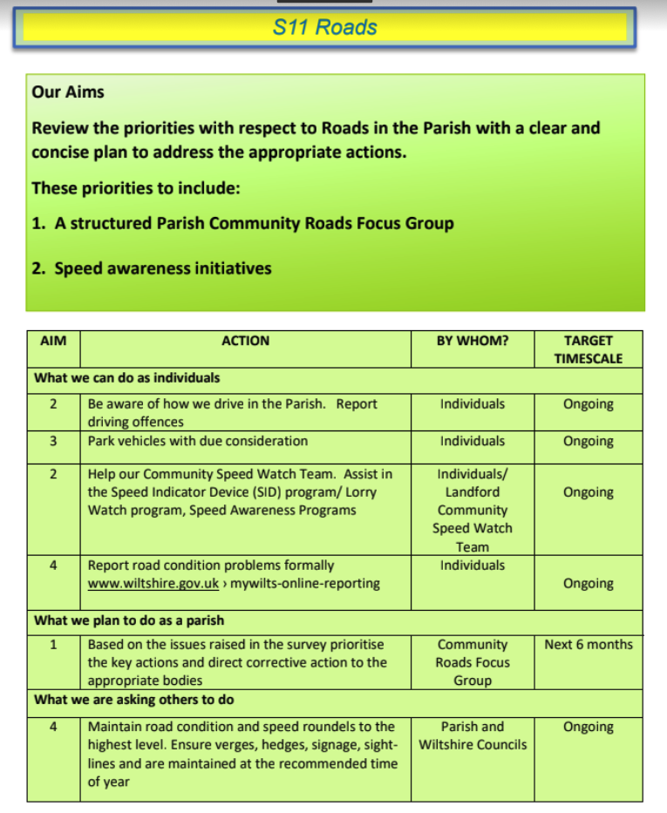
Voice of the Community
Keep our Parish roads safe
John Fairhurst 11th May 2022

Slide 9
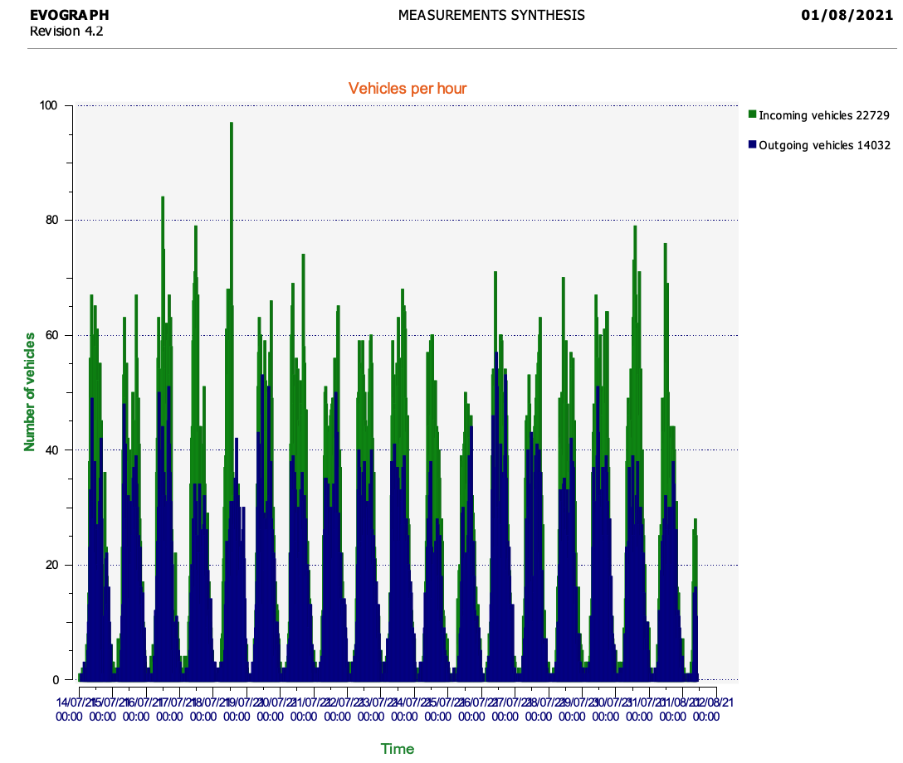
SID in action
John Fairhurst 11th May 2022

Slide 10
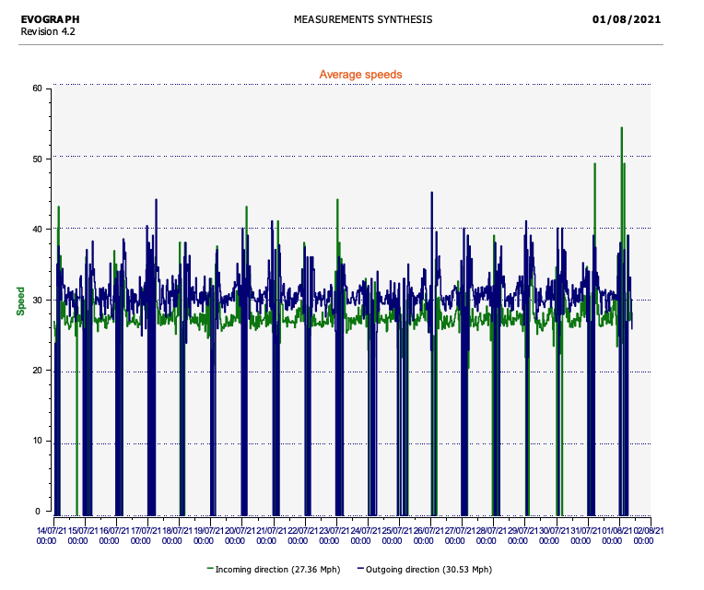
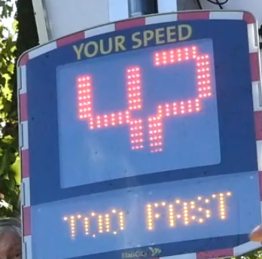

Slide 11
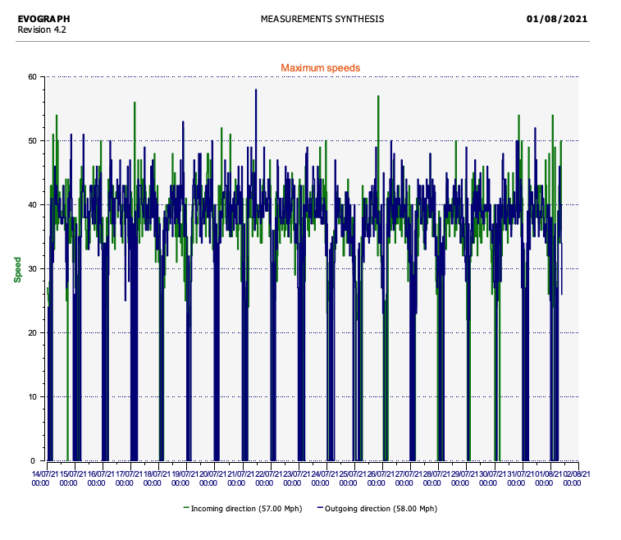

Slide 12
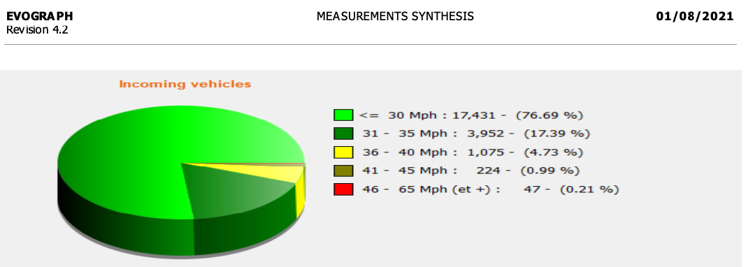

Slide 15
John Fairhurst 11th May 2022

Slide 16
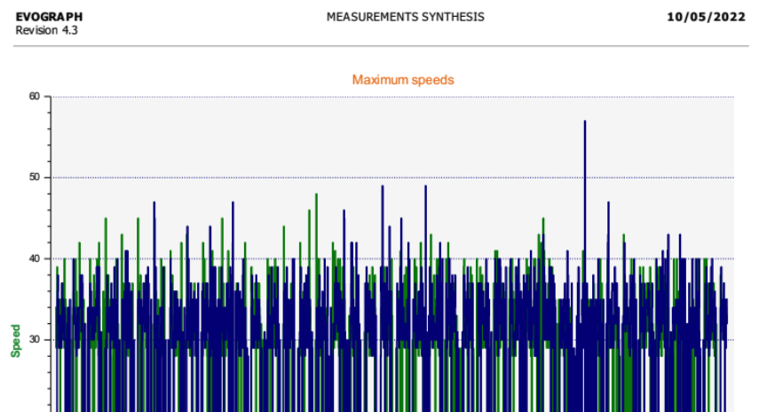
Sheffield English Road 29th March - 10 May 2022
John Fairhurst 11th May 2022

